Slide 1
Reviewing a network
Notes:
Teacher notes:
This presentation can be shown after learners have undertaken their practical activities to introduce how they can review their work.

Slide 2
Reviewing a network
Purpose and user requirements
User experience
  Reliability
  Performance
  Ease of use
Constraints
  Hardware and software availability
  Time and expertise
Templates
© Pearson Education Ltd 2012. Copying permitted for purchasing institution only.
Notes:
Teacher notes: PS 34
This is an overview of the presentation on what to look for when reviewing their networks.
The purpose and user requirements are important as these have to be the standards on which the network is judged in the review
The user experience is everything that affects how the network feels when it is used.
Reliability is important and any issues here need to be included in the review.
Performance is closely related to the user experience, but focuses on the speed of the system.
The ease of use looks at how simple and straightforward the network is from the user’s perspective.
How constraints such as hardware and software availability, time and expertise have limited what was achieved need to be recorded.
Templates can be used to help make the review quicker and more thorough.

Slide 3
Purpose and requirements
The purpose is the main reason for creating the network.
User requirements are what the users want from the network.
These are important as the end result needs to be compared to them.
© Pearson Education Ltd 2012. Copying permitted for purchasing institution only.
Notes:
Teacher notes: PS 35
The purpose is the main reason for creating the network. Does the end result match this?
User requirements are what the users want from the network. Does the end result match this?
The review needs to compare the network to these criteria.

Slide 4
User experience
The network needs to be reviewed on how it is to use in terms of:
  reliability
  performance
  ease of use.
© Pearson Education Ltd 2012. Copying permitted for purchasing institution only.
Notes:
Teacher notes: PS 36
The user experience focuses on how it is to use.
Any reliability issues or error messages need to be recorded as they reduce or spoil the user experience.
Performance is important as the system should feel fast and responsive.
Ease of use is considered against any awkward workarounds or log-ins the user has to carry out in order to use the network.

Slide 5
Constraints
These are the restrictions on what can be achieved because of some or all of:
  hardware availability
  software availability
  time
  Expertise.
© Pearson Education Ltd 2012. Copying permitted for purchasing institution only.
Notes:
Teacher notes: PS 37
Sometimes you cannot produce the network you want because of constraints.
These often apply to the network’s organisation setup and the availability of resources.
Hardware and software availability have a big impact, as does lack of time and expertise.
Learners’ reviews need to record any constraints encountered and their effects on the end-result.

Slide 6
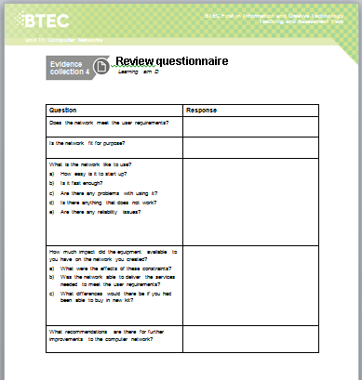
Templates
Forms pre-prepared with the questions that need to be addressed
Add structure to the review
Ensure nothing is left out of the review
Can be added to, if required
© Pearson Education Ltd 2012. Copying permitted for purchasing institution only.
Notes:
Teacher notes: PS 38
Pre-prepared templates with the questions that need to be addressed can help the reviews.
They add structure to the review and ensure nothing is left out.
The template provided can be added to, if required, or can be used as the basis for the documents learners produce for their reviews.

